Slide 1
Nuclear in Australia: What are the opportunities and challenges?
Jasmin Diab, CSC
Managing Director, Global Nuclear Security Partners
President, Women in Nuclear Australia

Slide 2
Nuclear Power as Base Load
Source: International Atomic Energy Agency

Slide 3
Automatic Load Adjustment
Source: HAL Open Science, NPP Flexibility at EDF

Slide 4
Capacity Factor
Source: US Department of Energy

Slide 5
Low reliance on critical minerals
Source: Our World in Data

Slide 6
Safety

Slide 7
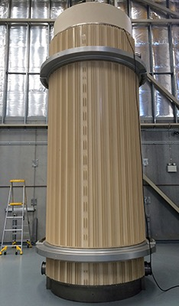
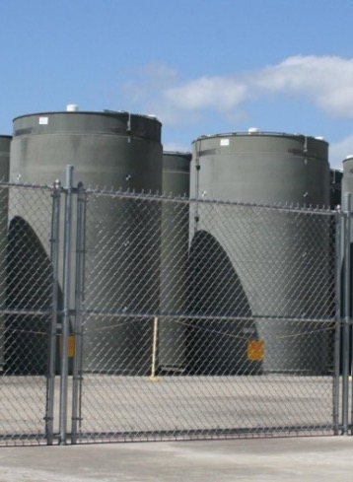
Waste
Low Level Radioactive Waste (LLW)
Intermediate Level Radioactive Waste (ILW)
High Level Radioactive Waste (HLW)
Source: ANSTO
Source: ARPANSA
Source: World Nuclear Association

Slide 8
Environmental Footprint

Slide 10
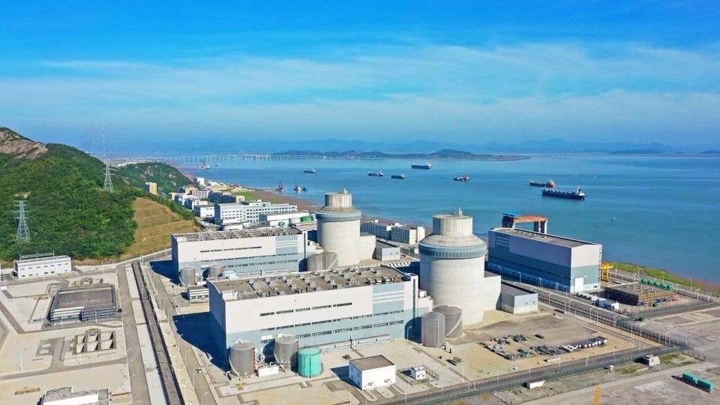
Easy solution - Coal to Nuclear
Small Modular Reactors – 300MW
Traditional Large Scale – 1000MW
Source: GE Hitachi
Source: Westinghouse
Notes:
AEMO’s 2023 WEM Statement of Opportunities was the first in which AEMO gave a forecast that took into account WA’s commitment to transitioning off coal-fired energy by 2030, which would strip approximately 1,400 MW of baseload power generation out of the system.
Collie – 350MW
Muja – 654MW (close 2025)
Replaced with 800MW solar and wind (add in capcity factor)
Private owned Bluewaters – 434MW
Close by 2029 – 5 years
Gap – gas firm up temporary gaps in supply (shortages)

Slide 11
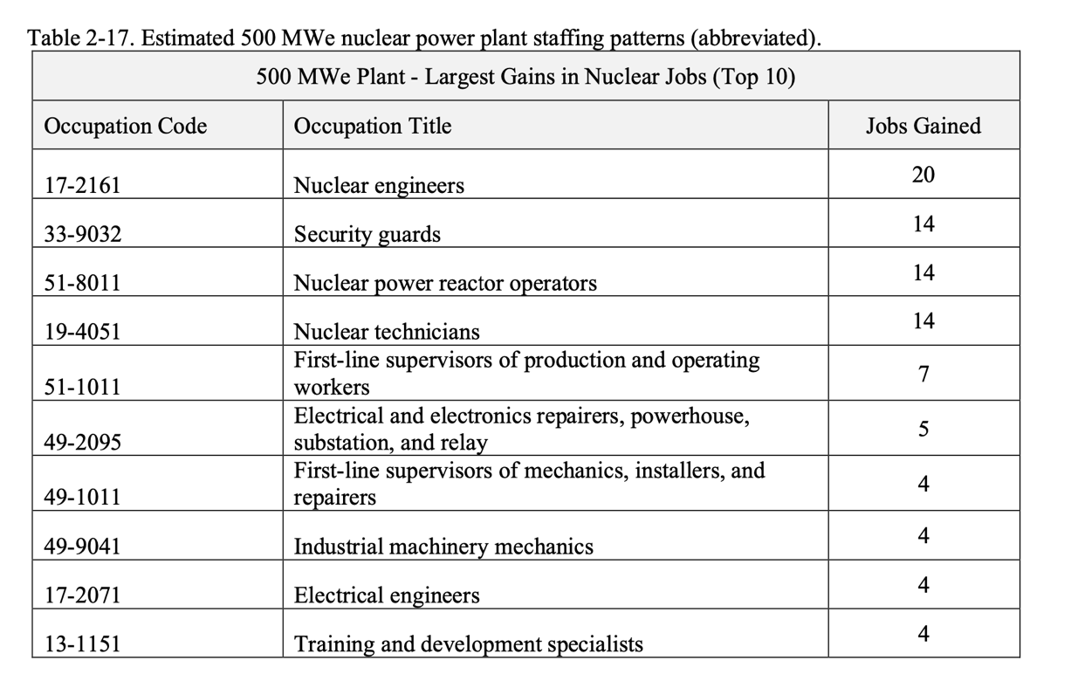
Coal to Nuclear Workforce – Nuclear Jobs
Total increase in nuclear jobs 90
Source: US Department of Energy
https://fuelcycleoptions.inl.gov/SiteAssets/SitePages/Home/C2N_Guidebook_2024.pdf

Slide 12
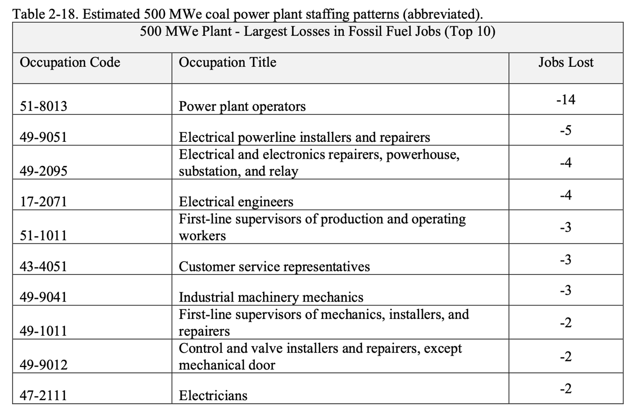
Coal to Nuclear Workforce – Coal Jobs
Total decrease coal jobs 42
Overall increase overall 48 jobs
Source: US Department of Energy
https://fuelcycleoptions.inl.gov/SiteAssets/SitePages/Home/C2N_Guidebook_2024.pdf

Slide 13
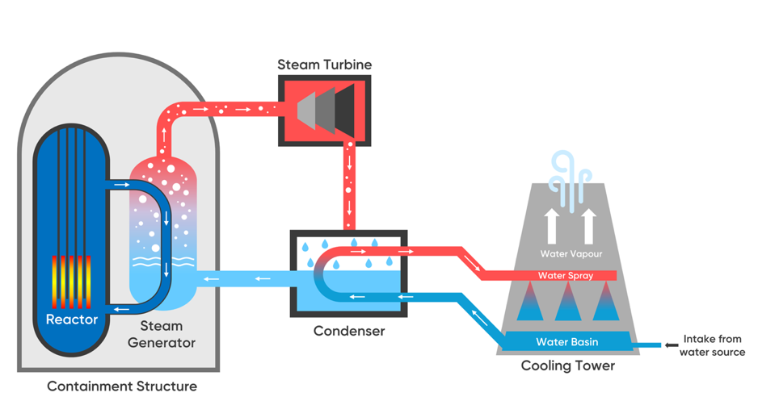
Water – How is it used?
Once through cooling system
Closed Loop cooling system
Source: UNSW

Slide 14
Water – Coal to Nuclear comparison
Source: UNSW

Slide 15
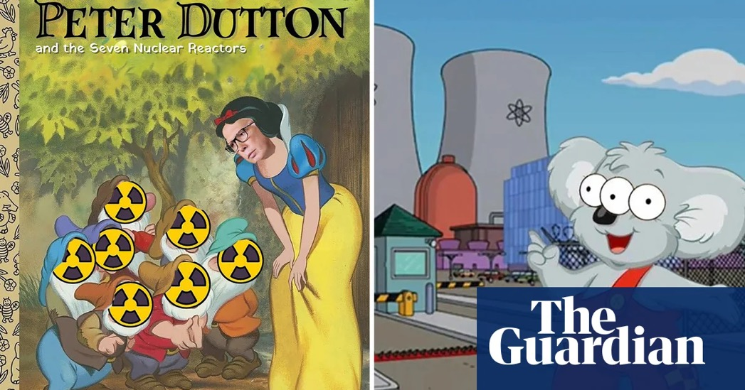
Nuclear’s Challenges in Australia
Public Perception
The Politics
High Initial Capital Costs
Construction time
Skills and expertise

Slide 16
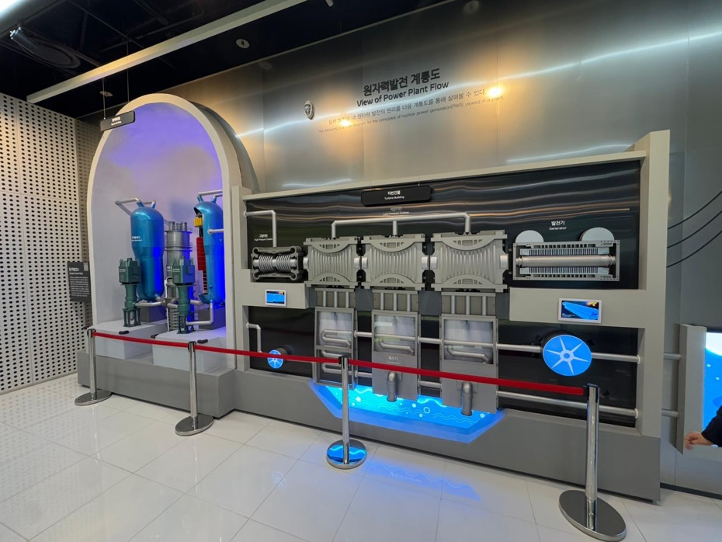
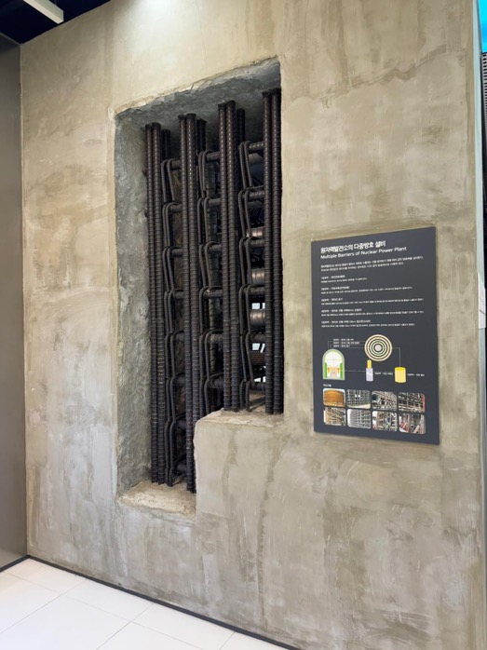
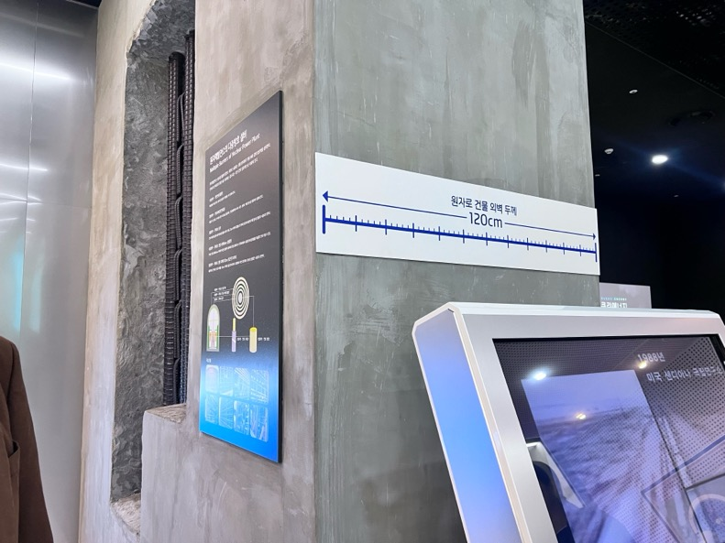
Community engagement and awareness

Slide 17
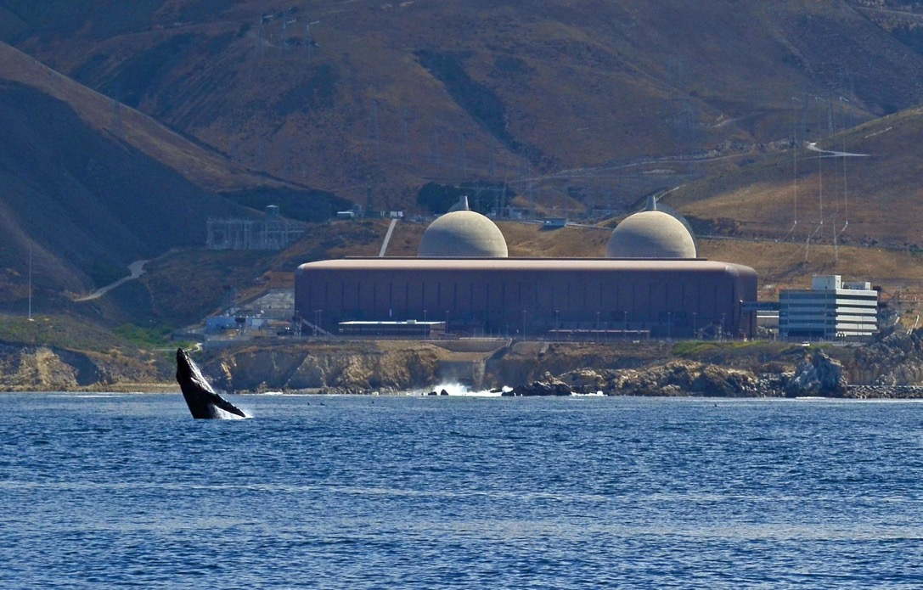
Thank You!
Jasmin Diab
Global Nuclear Security Partners
Jaz.diab@gnsp.global
https://www.nuclearforaustralia.com
Source: ANS – Diablo Canyon NPP (California)

